Slide 1

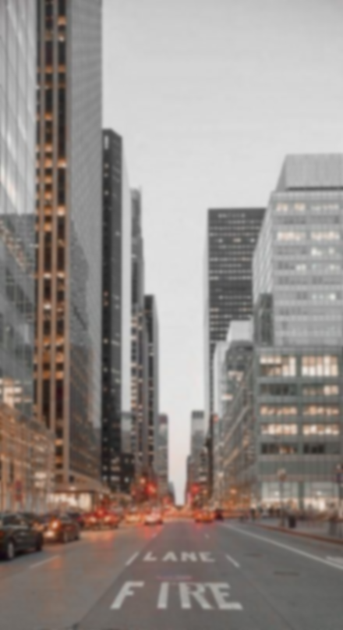




SafeDrive Innovation
Project

Slide 2






CONTENT

Slide 3
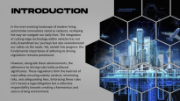

CONTENT
INTRODUCTION

Slide 4

CONTENT
SOLUTION

Slide 5

CONTENT
REALISATION

Slide 6
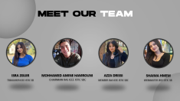

CONTENT
OUR TEAM

Slide 7


CONTENT
CONCLUSION

Slide 8



INTRODUCTION
Automotive innovations stand as catalysts, reshaping the way we navigate our daily lives.
Alongside these advancements, the adherence to driving rules holds profound significance. These regulations form the bedrock of road safety, ensuring orderly conduct, minimizing risks, and safeguarding lives.

Slide 9
Problematic
Despite stringent driving regulations, the prevalence of accidents persists, primarily attributed to factors like impaired driving and distracted driving
30%
25%
30% of road accidents stemming from impaired driving incidents.
while distracted driving contributes to nearly 25% of collisions annually.

Slide 10


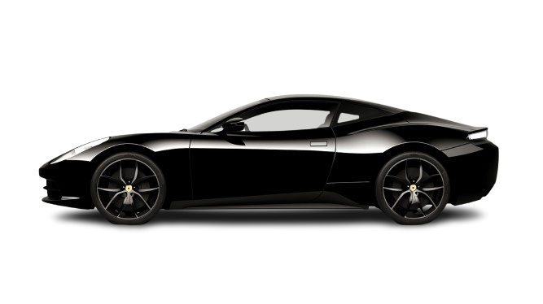
SOLUTION

Slide 11

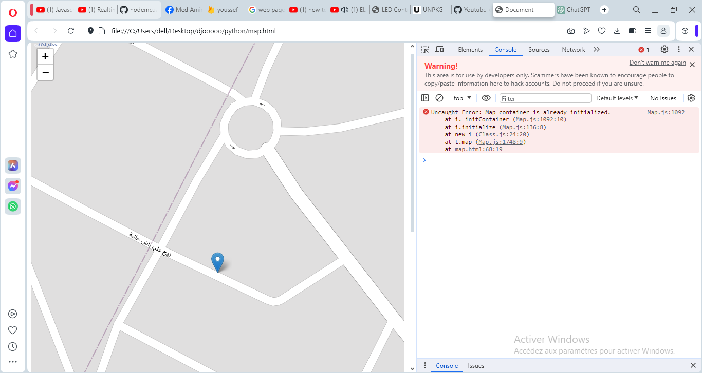




SOLUTION
Testing alcohol %
% Low
% High
the user can drive, but there's a speed limit they must not exceed
the sensor sends a message to the list of people the user declared beforehand

Slide 12
SOLUTION
Sensors for distance detections

Slide 13
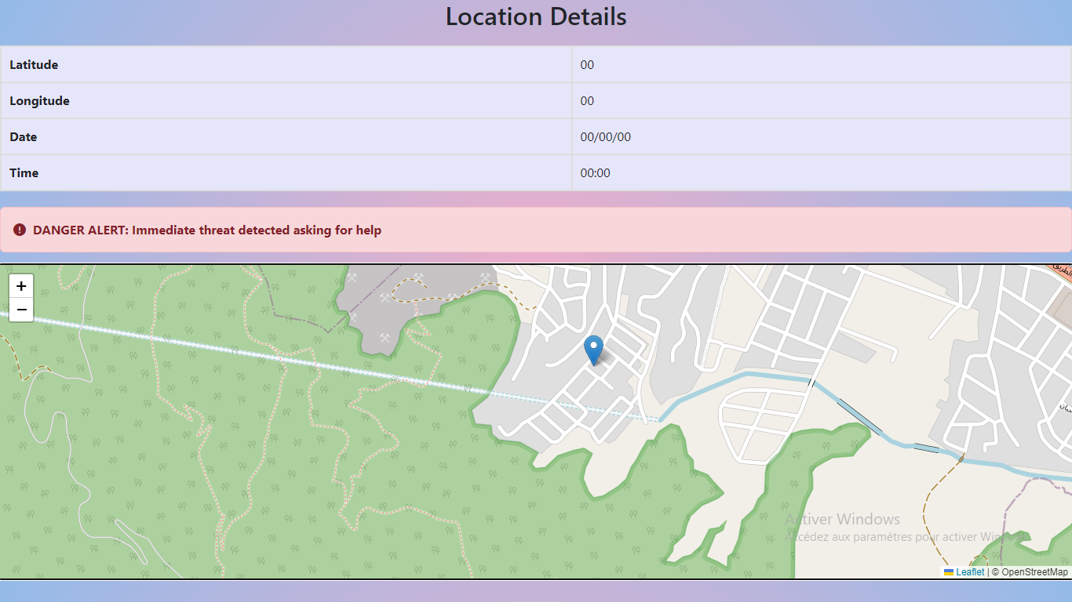
Our Application
Safety Pilot

Slide 14



OUR VISION
“A future where technological innovation and a collective commitment to responsible driving reshape the roads into safer and more secure environments for everyone.”

Slide 15

6
5
MATERIAL
1
4
REALISATION
2
3

Slide 16
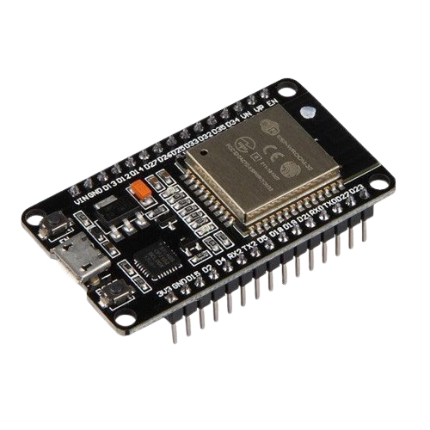
6
5
MATERIAL
1
4
MATERIAL
2
3

Slide 17
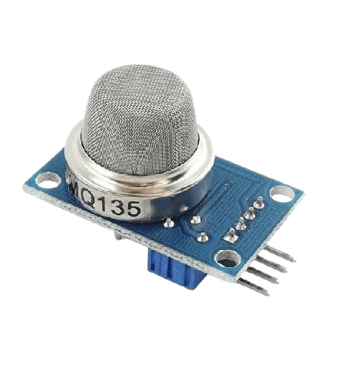
6
1
5
MATERIAL
MATERIAL
REALISATION
4
2
ESP-32
3

Slide 18
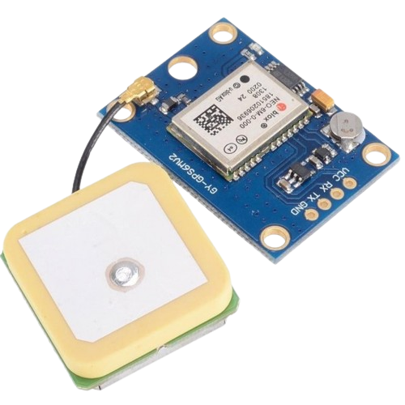
1
2
6
MATERIAL
5
MQ135 CAPTEUR GAZ BENZEN ALCOOL ET FUMEE
3
4

Slide 19
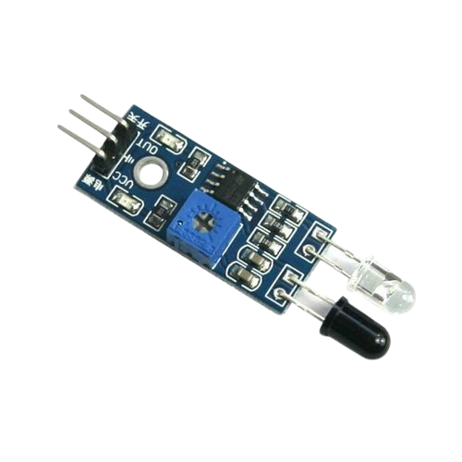
2
3
1
MATERIAL
6
4
GPS Module GY-NEO6MV2
5

Slide 20
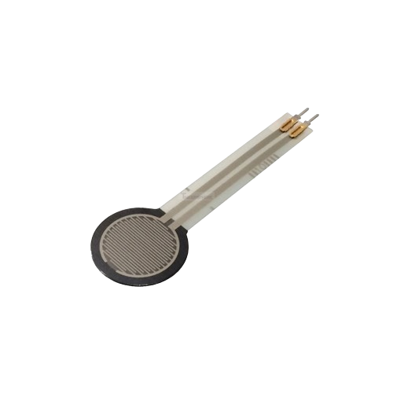
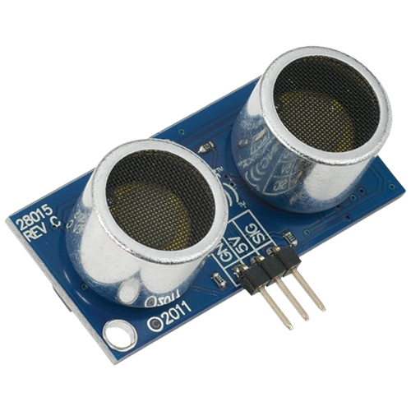
3
4
2
MATERIAL
1
5
Capteur ultrason
6

Slide 21
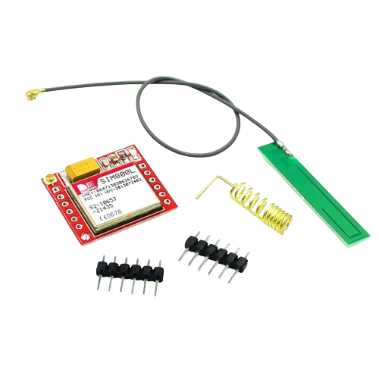
4
5
3
MATERIAL
2
Capteur de Force FSR402 0.5
6
1

Slide 22
5
6
4
MATERIAL
3
SIM800L GSM GPRS Module
1
2

Slide 23


CONCLUSION
The system has several advantages. It is non-invasive, as it does not require a breath sample. It is also discreet, as it can be integrated into the car dashboard. Finally, it is effective, as it can detect drunk drivers with great accuracy.
We are confident that our system can help save lives. We call on public authorities and the automotive industry to support our project.

Slide 24
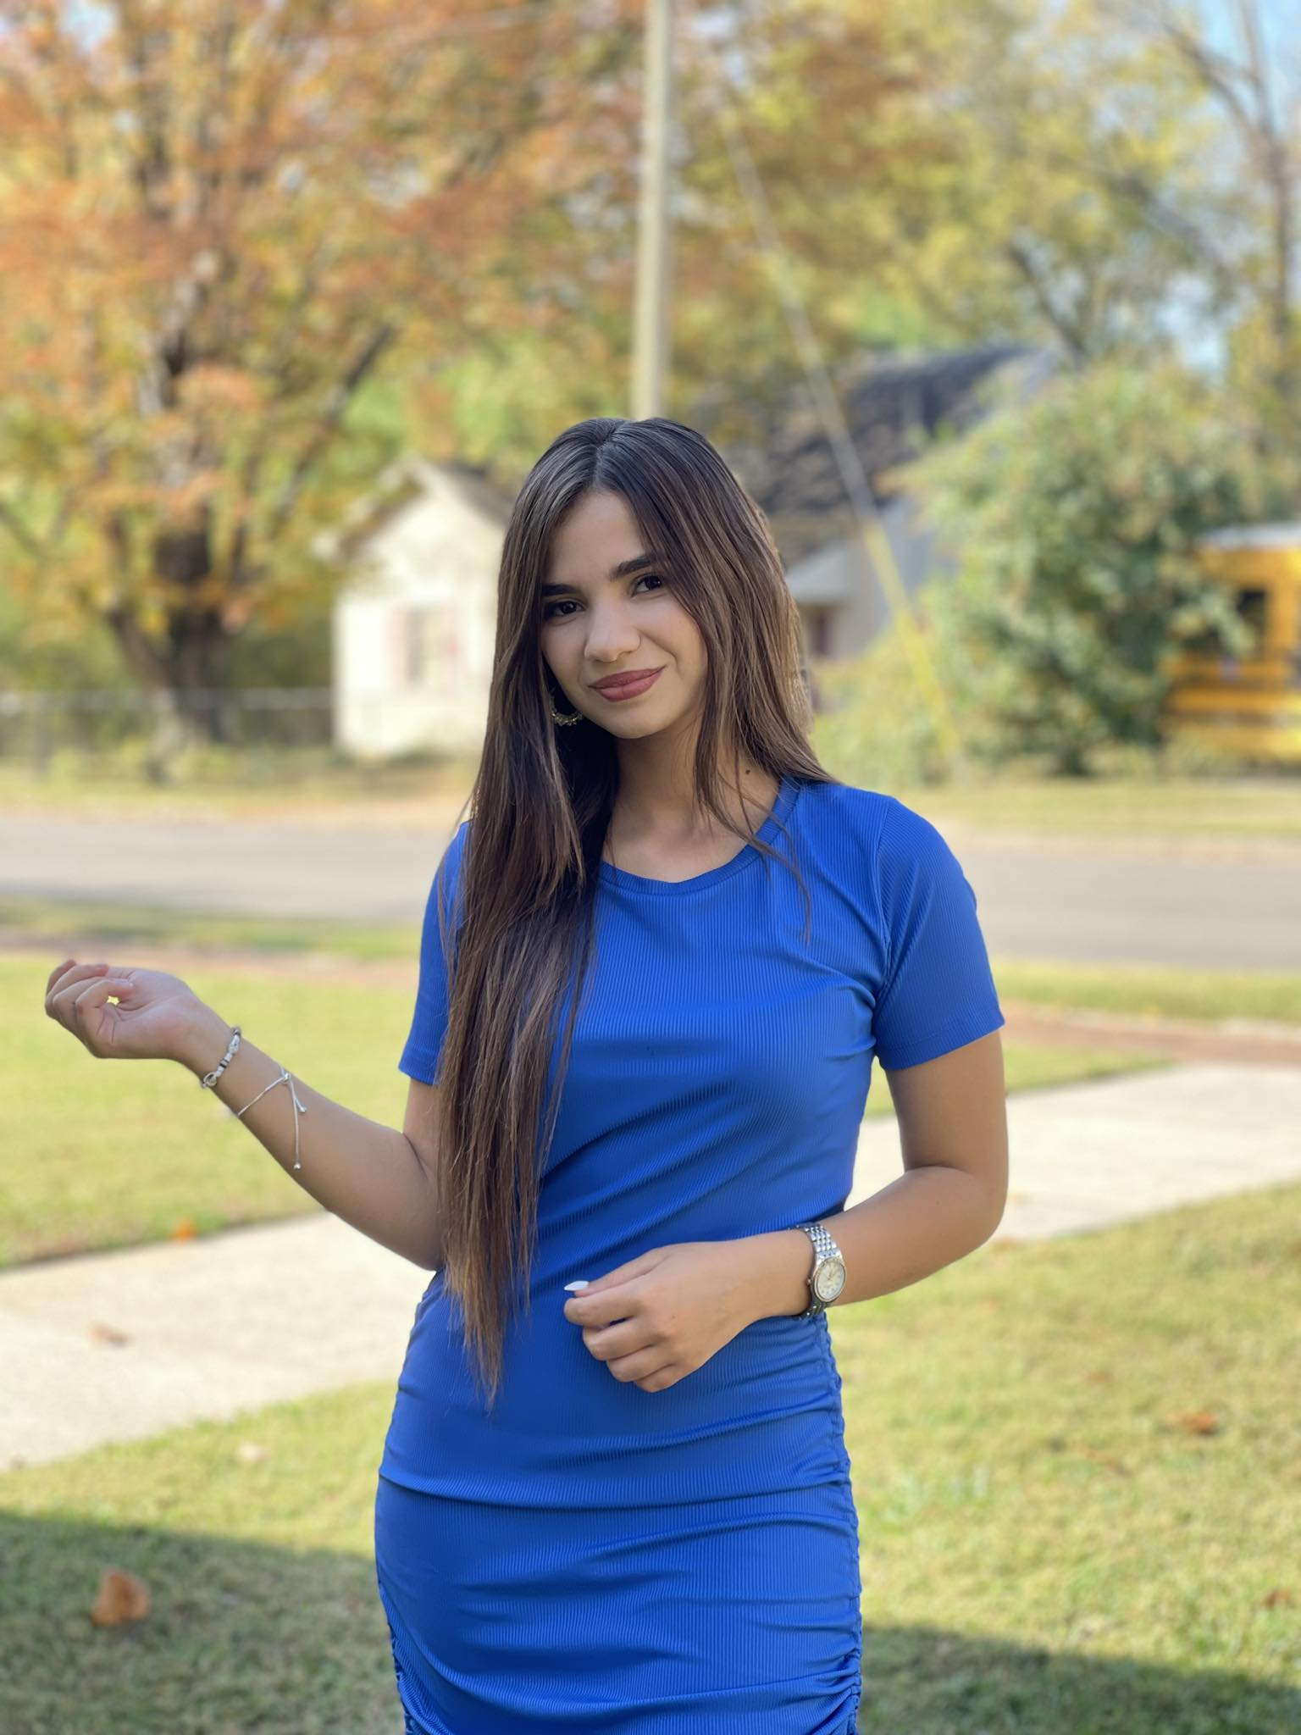
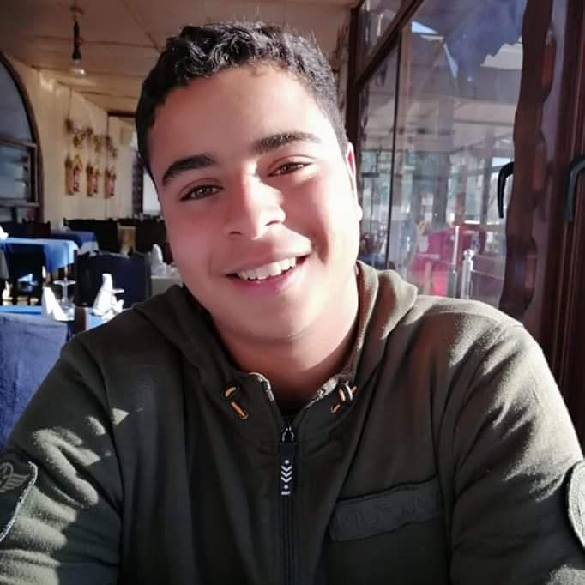
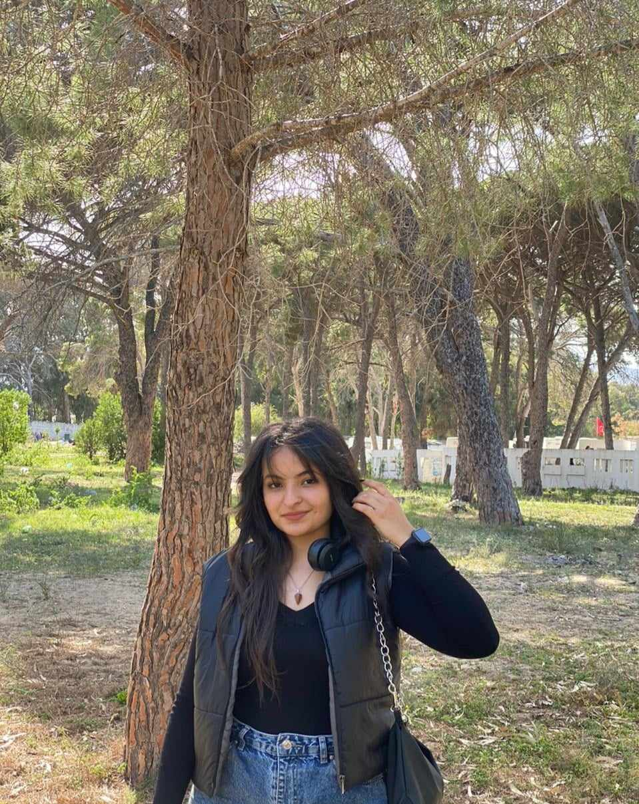
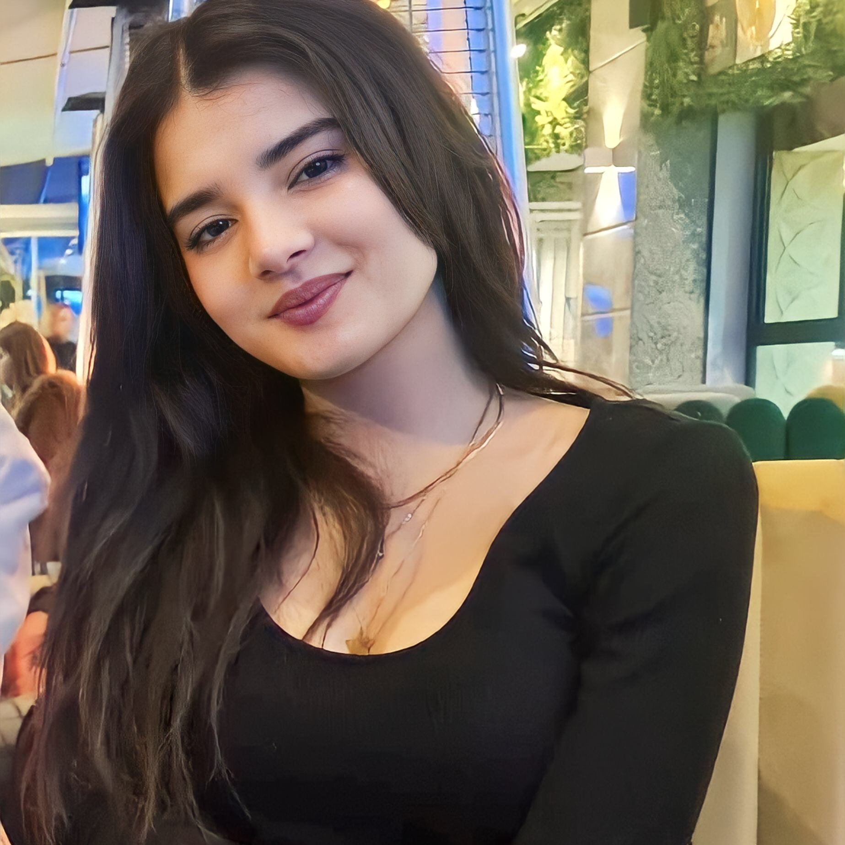
MEET OUR TEAM
ISRA ZGUIR
MOHHAMED AMINE HAMROUNI
AZZA DRISSI
SHAIMA HMEM
TREASURER IEEE ISTIC SB
CHAIRMAN RAS IEEE ISTIC SBC
MEMBER RAS IEEE ISTIC SBC
WEBMASTER IEEE ISTIC SB

Slide 25
THANKS ANY QUESTIONS ?

